Slide 1
HUMAN ANATOMY
Introduction
By P.J. Okoth

Slide 2
Definition
Dissection or the separation of the body into its parts, and giving an accurate description of the parts.
The study of the structure of the human body and the physical relationships involved between body parts.

Slide 3
History
What prompted the study of human anatomy?
The need to cope with injury, disease and death
The generation of images for aesthetic, magical or religious purposes
A strong element of curiosity about the mysterious nature of human life and its mechanisms.

Slide 4
History
The first recorded school of anatomy was in Alexandria (from about 300BC to the 2nd century AD) where the renowned anatomical teachers Herophilus and Erasistratus dissected the human body and described many of its structures.

Slide 5
History…
The most influential anatomist in the ancient world was Galen (approx. 130-200AD), a physician and prolific writer who studied anatomy in Alexandria.
Many terms used in anatomy have roots in Galen’s work.
The foundation stone of modern anatomy is the work of Andreas Vasalius: De Fabrica Corporis Humani, published in 1543.
Prolific = producing many works

Slide 6
Types / divisions of anatomy
Gross Anatomy
Microscopic Anatomy
Developmental Anatomy
Comparative Anatomy

Slide 7
Divisions of Anatomy
Gross Anatomy
Structures that can be seen with the eye
Muscles, bones, various organs
Can be regional or systemic
Microscopic Anatomy
Structures that cannot be seen with the eye
Need to use a microscope
Cytology = study of cells
Histology = study of tissues

Slide 8
Developmental Anatomy
Definition:
The study of anatomical changes in a life cycle
Kinds:
Embryology:
The study of prenatal development
Postnatal development:
The study of structures after birth
Ontogeny:
Total development of an individual

Slide 9
Comparative Anatomy
Definition:
Comparison of structures between organisms
Kinds:
Vertebrate:
Comparison of structures among the vertebrate classes
Phylogeny:
The study of phyla, and their relationships

Slide 10
Ways to Study Anatomy
Regional Anatomy – study one region of the body at a time and learn everything about the region
Systemic Anatomy – study one body system at a time. This is the approach we will use in this course

Slide 11
Anatomical Organization
Cells
Tissues
Organs
Organ Systems
Organism

Slide 12
System = a group of many organs with functions closely linked together.
Organ = a complex structure (of different tissues) with a specific function.
Tissue = cluster of cells with similar characteristics. Tissues are distributed throughout the body.

Slide 13
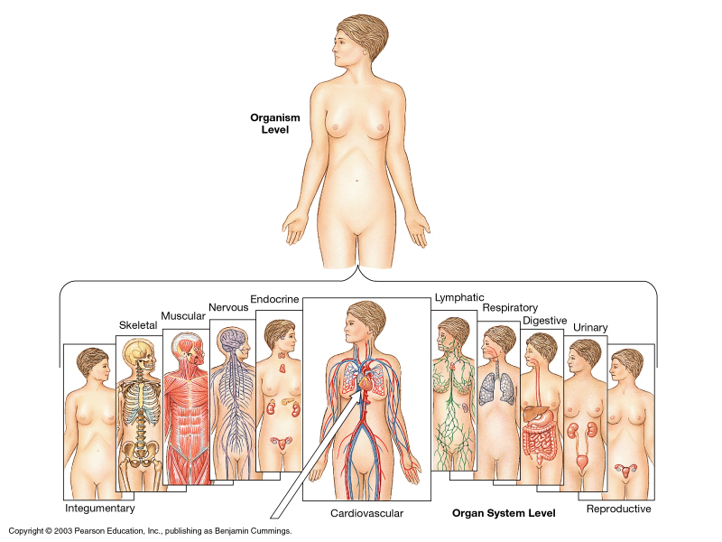

Slide 14
Organ Systems
Integument
Skeletal
Muscular
Nervous
Endocrine
Cardiovascular
Lymphatic
Respiratory
Digestive
Urinary
Reproductive

Slide 15
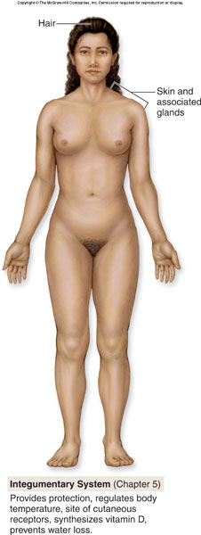
Integumentary System
Components
Skin
Hair, nails
Function
External covering
Protection
Synthesis of Vitamin D
Location of Sense receptors

Slide 16
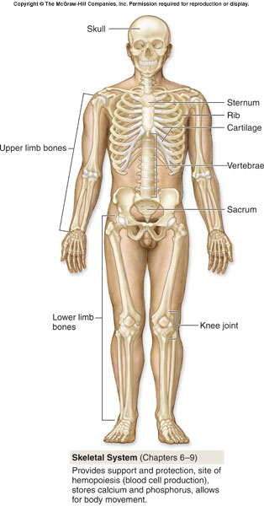
Skeletal System
Components
Bones
Joints and adjacent cartilages
Function
Support
Protection
Movement
Blood cell production (red bone marrow)
Mineral storage (calcium and phosphorus)

Slide 17
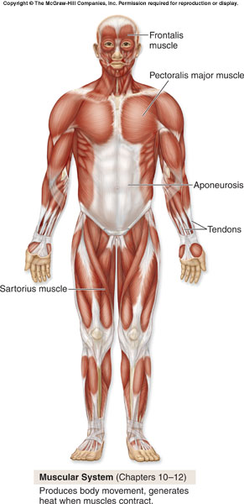
Muscular System
Components
Skeletal Muscles
Associated Connective Tissues (tendons)
Function
Locomotion
Manipulation of the environment
Facial expression (communication)
Maintain posture
Produce heat

Slide 18
Circulatory System
Components
Cardiovascular System
Lymphatic System
Function
Transportation of materials
Within the body
To and from internal and external environments

Slide 19
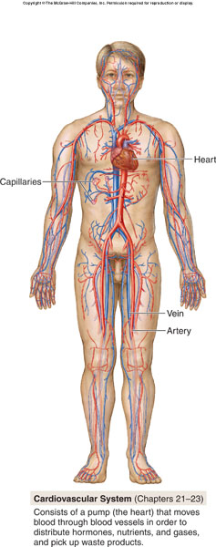
Cardiovascular System
Components
Heart
Vessels
Function
Transportation of blood
Blood contains O₂ and CO_{2,} nutrients, wastes, etc.
Blood composed of plasma and cells

Slide 20
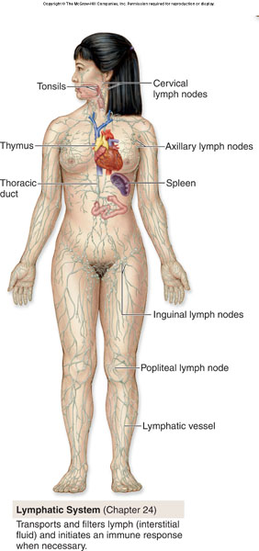
Lymphatic System
Components
Lymphatic Organs (spleen, lymph nodes, thymus, etc.)
Lymphatic Vessels
Function
Transportation of lymph
Lymph is derived from tissue fluid

Slide 21
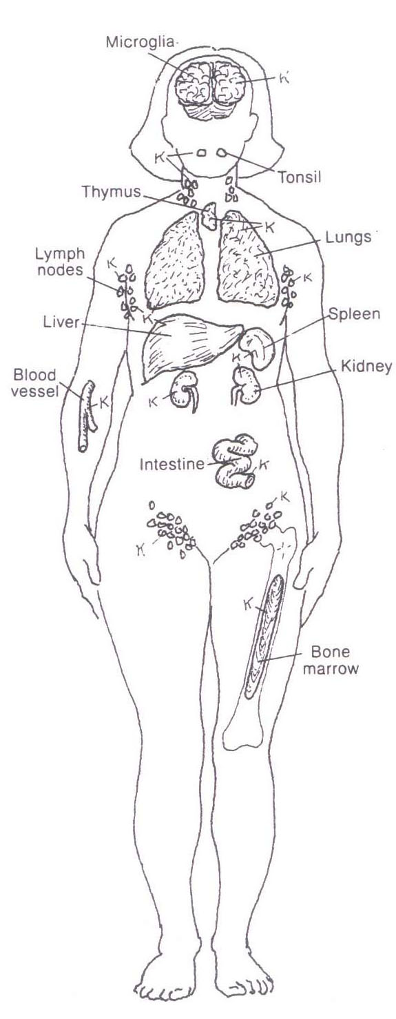
Immune System
Components
Immune Organs (red bone marrow, thymus, etc.)
White blood cells (lymphocytes, macrophages, etc.)
Function
Defense (Immune response)

Slide 22
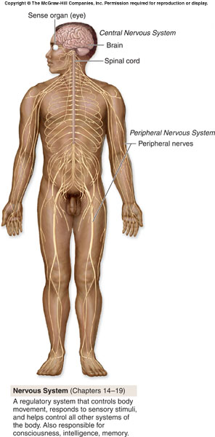
Nervous System
Components
Brain, Spinal cord (CNS)
Nerves (PNS), sense receptors
Function
Control system (fast, “hard wired”)
Response to external and internal environments

Slide 23
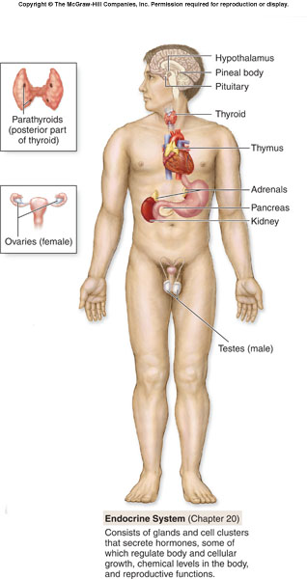
Endocrine System
Components
Glands that secrete hormones
E.g. pituitary, pancreas, thyroid
Function
Control system (slow, “chemical”)
Regulates processes such as growth, reproduction and nutrient use

Slide 24
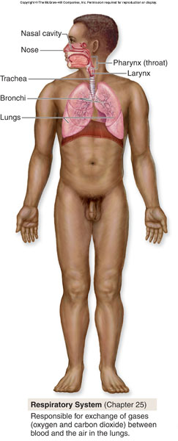
Respiratory System
Components
Lungs
Tubing ( trachea, bronchus, etc.)
Larynx (vocal cords)
Function
Exchange of respiratory gases (O₂ and CO₂)
Between blood and atmosphere
Voice production

Slide 25
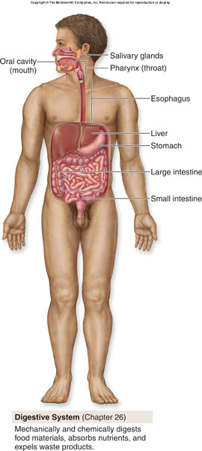
Digestive System
Components
Alimentary canal (mouth, pharynx, esophagus, stomach, small intestine, large intestine)
Accessory structures(liver, salivary glands, etc.)
Function
Break down food into small, absorbable pieces
Absorption of nutrients between blood and lumen
Eliminate waste

Slide 26
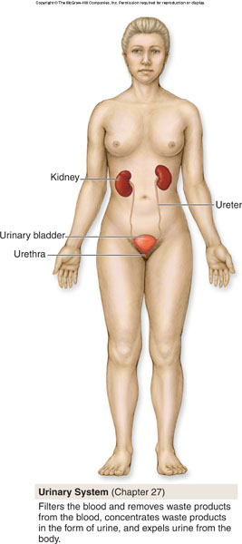
Urinary System
Components
Kidneys, Ureters, Urinary bladder, Urethra
Function
Eliminate waste (nitrogen) from blood
Between blood and external environment
Regulates water, electrolytes, acid/base

Slide 27
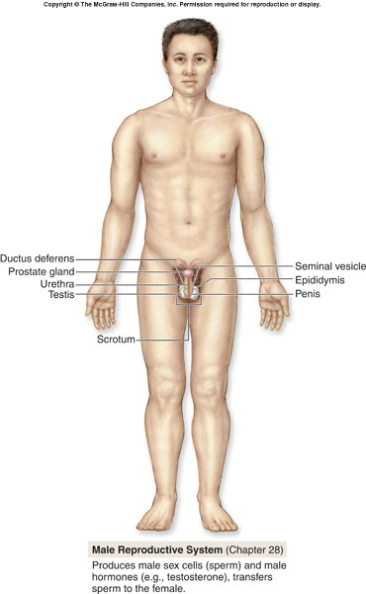
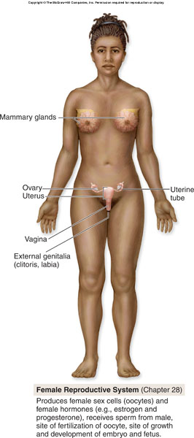
Reproductive System
Components
Male Reproductive System
Female Reproductive System
Function
Perpetuation of the species
Hormones influence structure and function

Slide 28
Anatomical Terminology
Definitions

Slide 29
Anatomical position
All anatomical descriptions are expressed in relation to the anatomical position.
The anatomical position refers to a person as if he were standing erect, with:
Head, eyes, and toes directed anteriorly (forward)
Upper limbs by the sides with the palms facing anteriorly
Lower limbs together with the feet directed anteriorly
* the body is upright, facing forwards (anteriorly), with the palms also anterior.

Slide 30
Anatomical Planes
A plane is an imaginary surface that slices the body into specific sections.
Anatomical descriptions are based on four anatomical planes that pass through the body in the anatomical position.
There are many sagittal, frontal, and transverse planes but there is only one median plane.
The main use of anatomical planes is to describe sections and images of the body.

Slide 31
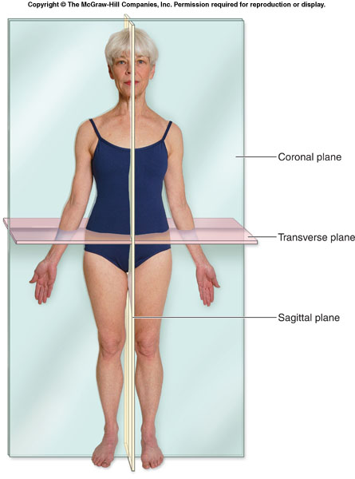

Slide 32
Median plane
Also called median sagittal plane
It is the vertical plane passing longitudinally through the center of the body – dividing it into right and left halves.

Slide 33
Sagittal planes
Are vertical planes passing through the body parallel to the median plane.
A point of reference indicating its position is usually indicated e.g. sagittal plane through the midpoint of the clavicle.

Slide 34
Frontal planes (Coronal planes)
Are vertical planes passing through the body at right angles to the median plane, dividing it into anterior (front) and posterior (back) portions.

Slide 35
Horizontal planes (transverse planes)
Are planes passing through the body at right angles to the median and frontal planes.
A horizontal plane divides the body into upper and lower parts.
A reference point indicating its level, e.g. a horizontal plane through the umbilicus, is usually given.
Also referred to as transaxial planes or simply axial planes by radiologists.

Slide 36
Terms of relationship and comparison
Superior (cranial) – Nearer to head
Inferior (caudal) – Nearer to feet
Anterior (ventral) – Nearer to front
Posterior (dorsal) – nearer to back
Medial – Nearer to median plane
Lateral – Farther from median plane
Proximal – Nearer to trunk or point of origin (e.g. of a limb)
Distal – farther from trunk or point of origin (e.g. of a limb)

Slide 37
Terms of relationship and comparison
Superficial – nearer to or on surface
Deep – farther from surface
Dorsum – the superior or dorsal surface of hand or foot
Palm – the flat of the hand exclusive of the thumb and fingers
Sole – the inferior aspect or bottom of the foot

Slide 38
Terms of relationship and comparison…
Combined terms
Describe intermediate positional arrangements. E.g.
Inferomedial – nearer to the feet and closer to the median plane
Superolateral – nearer to the head and farther from the median plane
Posterolateral
Anterosuperior , etc.

Slide 39
Terms of laterality
Paired structures having right and left members such as the kidneys are bilateral
Those occurring on one side only are unilateral.
Ipsilateral means occurring on the same side of the body. E.g. the right thumb and right great toe are ipsilateral.
Contralateral - occurring on the opposite side of the body.

Slide 40
Terms of movement
These describe movements of the limbs and other parts of the body.
Movements take place at joints. The movements are described as pairs of opposites.
Flexion – bending of a part or decreasing the angle between body parts
Extension – straightening a part or increasing the angle between body parts.
Abduction – moving away from the median plane of the body in the frontal plane.
Adduction – moving toward the median plane of the body in the coronal plane.

Slide 41
Terms of movement
Rotation – moving a part of the body around its long axis
Medial rotation turns the anterior surface medially
Lateral rotation turns the anterior surface laterally
Circumduction – the circular movement of the limbs, or parts of them, combining in sequence the movements of flexion, extension, abduction, and adduction.

Slide 42
Terms of movement
Pronation – a medial rotation of the forearm and hand so that the palm faces posteriorly.
Supination – a lateral rotation of the forearm and hand so that the palm faces anteriorly, as in the anatomical position.
Eversion – turning sole of foot outward
Inversion – turning sole of foot inward

Slide 43
Terms of movement
Protrusion (protraction) – to move anteriorly e.g. of jaw.
Retrusion (retraction) – to move [the jaw] posteriorly.
Elevation raises or moves a part superiorly
Depression lowers or moves a part inferiorly.

Slide 44
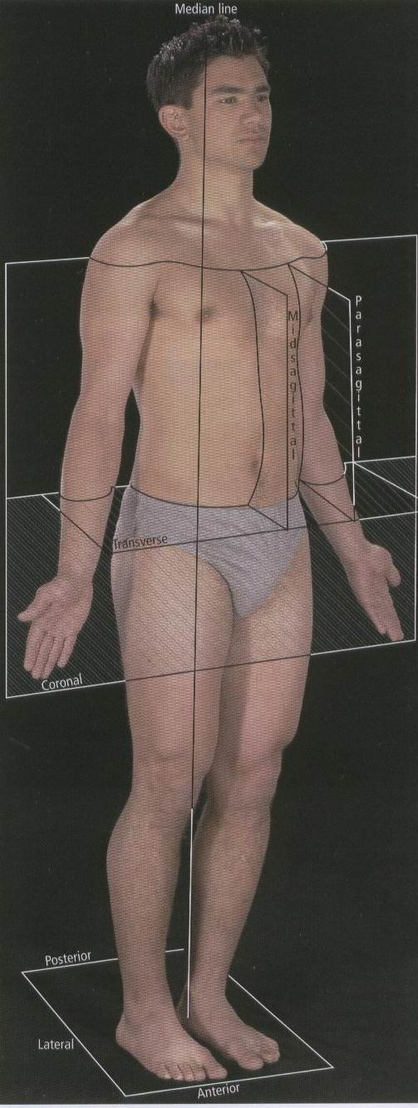
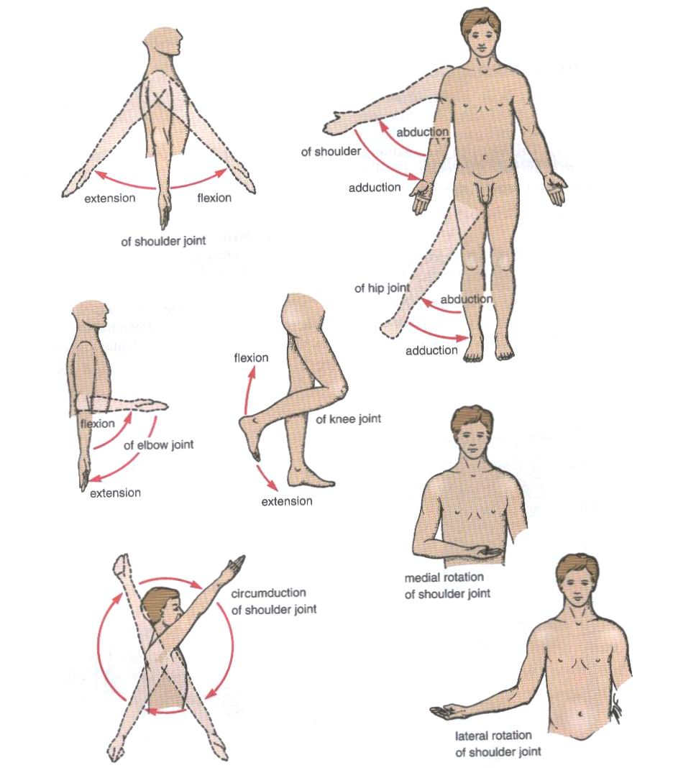

Slide 45
Thank you
The end!

